Slide 1

Predictive Analysis on H1B Data using SAS Miner
Arundhati Patil
Palak Tater
Shruti Sridharan
Varsha Sharma
https://public.enigma.com/spotlight/newsworthy/h1-b-visa-applications

Slide 2

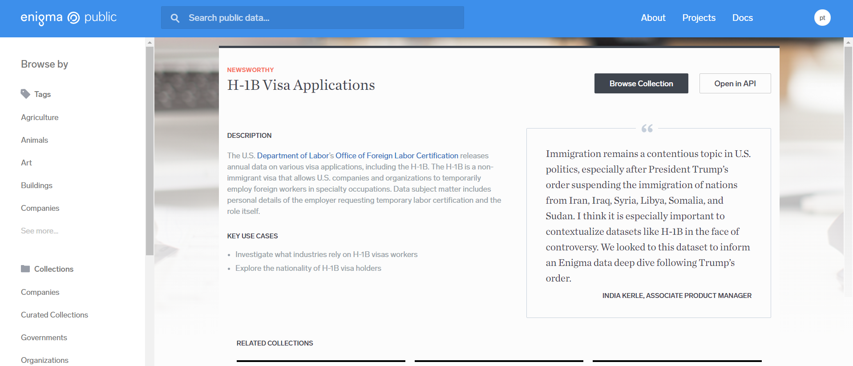

Motivation
Immigration remains a contentious topic in U.S. politics, especially after President Trump’s order suspending the immigration of nations from Iran, Iraq, Syria, Libya, Somalia, and Sudan.
The Office of Foreign Labor Certification (OFLC) generates program data that is useful information about the immigration programs including the H1-B visa. Since H1-B visa petition is closely related to international students we hoped that we can get a general idea about the relation between H1-B visa application status and features like job title, prevailing wage, etc..

Slide 3
Objective
This project is a classification problem since we have to predict whether a given case would be “Certified” or “Denied”.
Mine H1B Visa application data
Use SAS Enterprise Miner
To create models and understand patterns in the H1B visa case status
To identify important factors affecting the H1B visa decision.
.
After analyzing the data, we can derive the following insights:
What factors are affecting the most in H1B visa case decisions?
How are prevailing wages affecting the visa applications?
Which are the leading geographical demographics in H1B applications every year?
Which job titles have the most H1B applications and trends in the data?

Slide 4

Removing N/As
Correcting Class Imbalance
Removing Insignificant Variables
Designed New Variables
Parsing and Sample Randomization
Removed Case Sensitivity
Dataset Population:
H1B analysis of 2015,2016 &2017
1891306 Case ID’s,
41 attributes
Randomized Data selection 13692 Case ID’s
14 attributes , 1 Target & 13 Independent explanatory variables

Slide 5
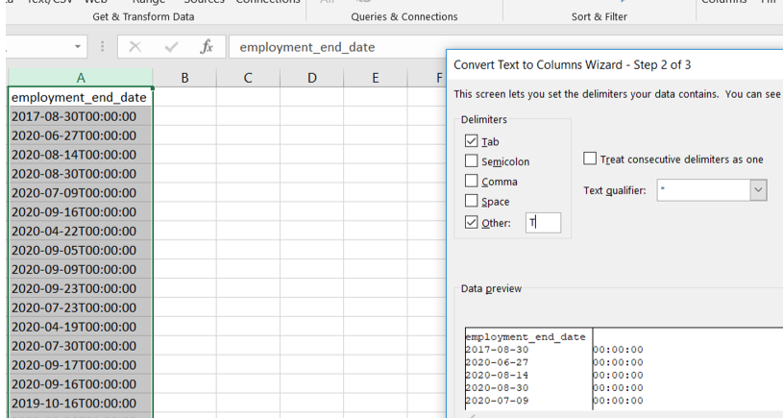
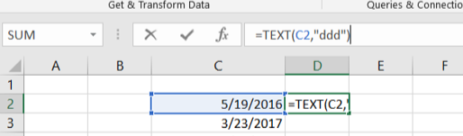
Challenges Faced
To compare wages of any two records in our data set, we converted them to the same time scale of payment (i.e. yearly)
Extracted year of Submission from date of case submitted by PARSING the data
Extracted day of submission by using the formula =TEXT(B4,"ddd")
Segregated target variable Case Status into positive class(1) and Negative class (0) with Certified, Certified-Withdrawn as Positive class and Denied as Negative class

Slide 6
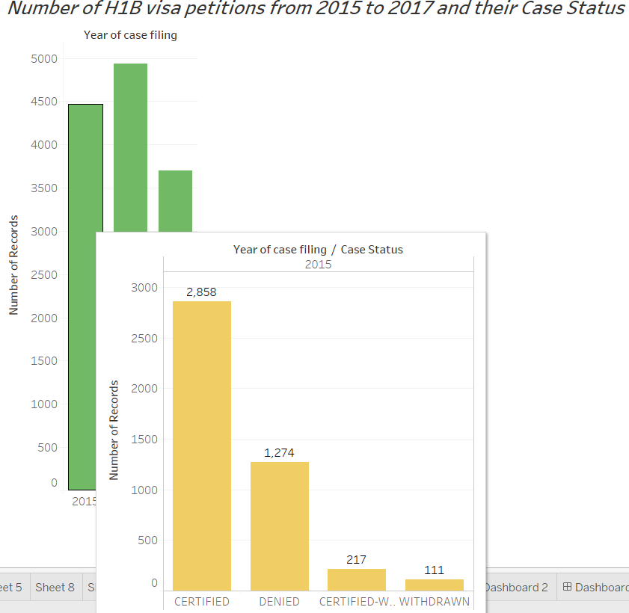
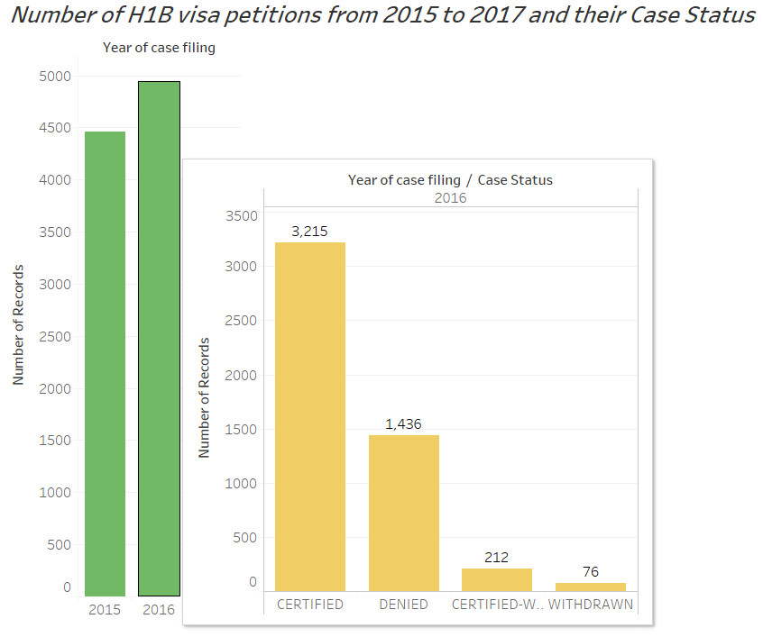
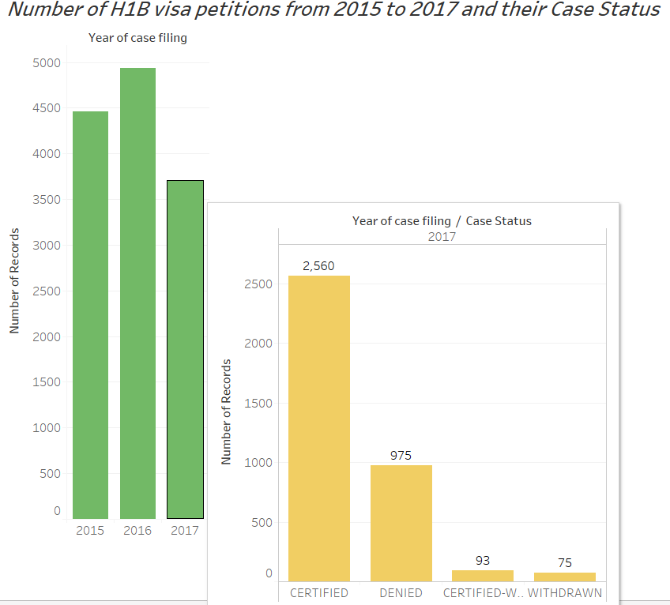
Let’s do some Exploratory Data Analysis…
In 2015, there were 4460 applications filed out of which 2858 were certified and 1274 were denied. In 2016, highest number of applications (4939) were filed, out of which 3215 were certified and 1436 were denied. In 2017, there was a decrease in the number of applications as compared to previous years(3703). Here 2560 applications were certified and the remaining rejected.
Link to Tableau Visualization Dashboard
https://public.tableau.com/profile/arundhathi.patil#!/vizhome/AnalysisonH1Bvisaapplications/Story2

Slide 7
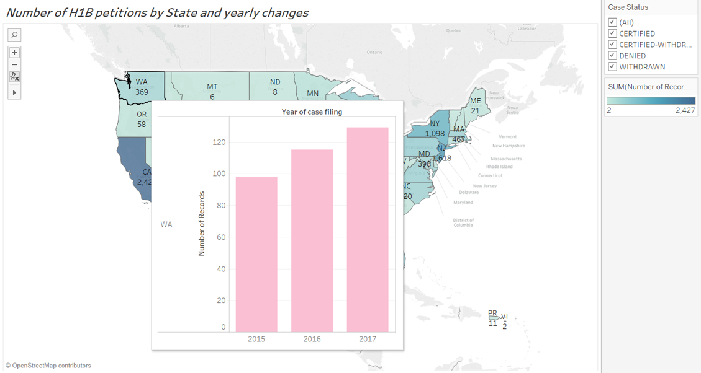
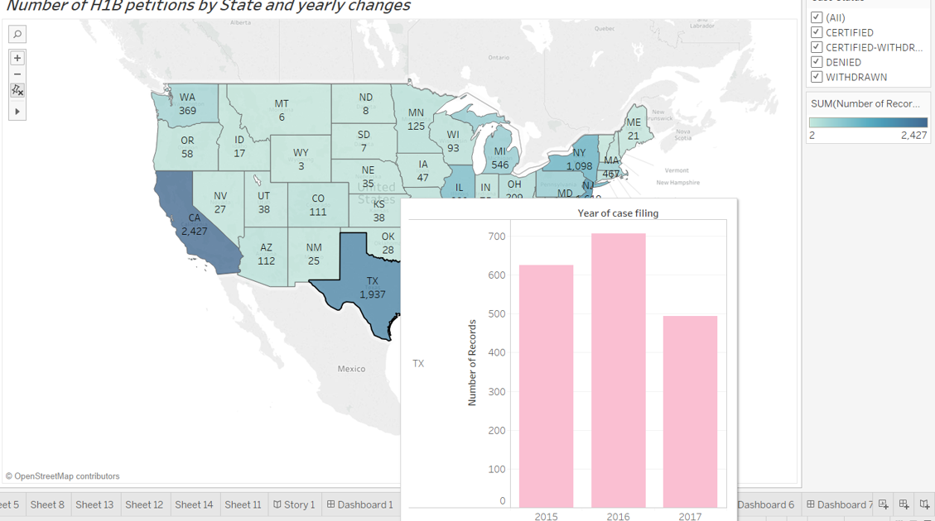
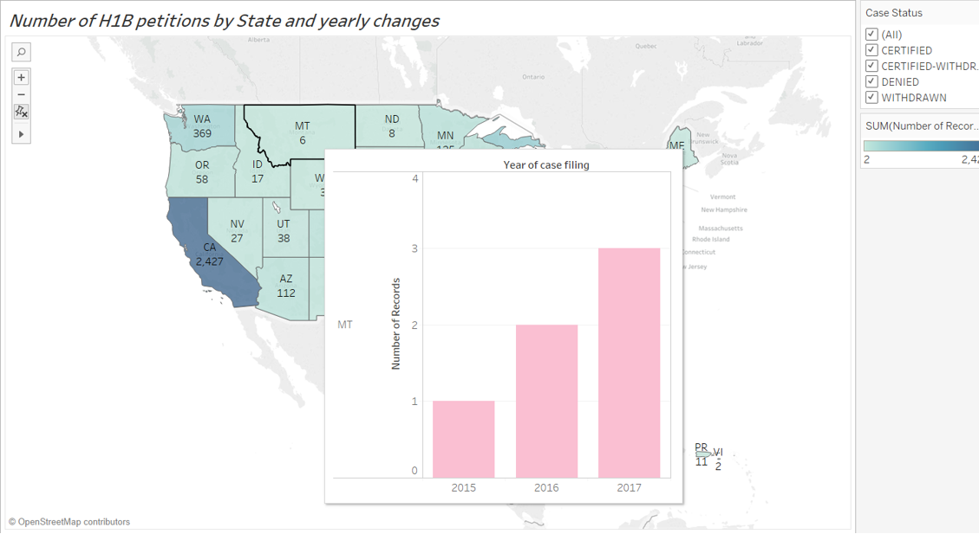
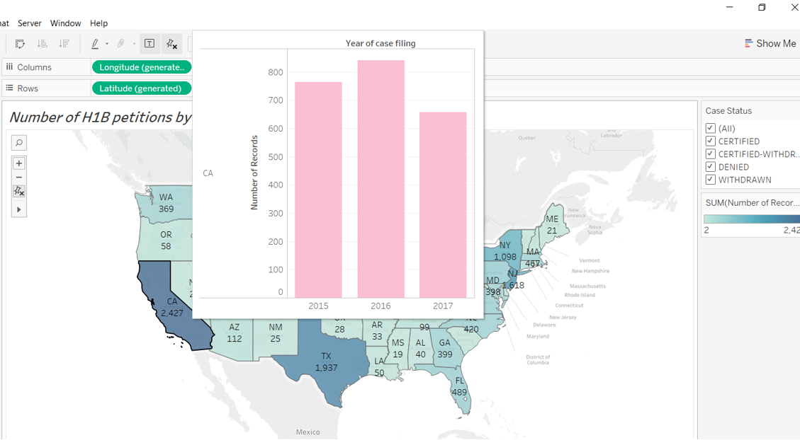
States like California, New York, Texas and Illinois show a decreasing trend in the number of H1B applications. However generally these states have the maximum concentration of employers.
Despite the changes in visa regulations proposed by the new government, states like Washington, Montana, Idaho and North Dakota have a increasing trend in the number of H1B applications filed.

Slide 8
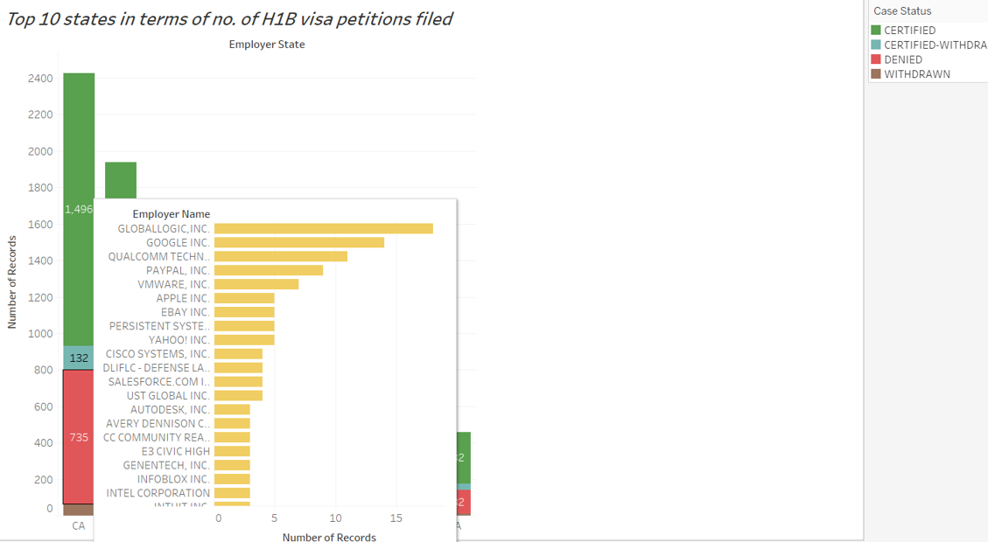
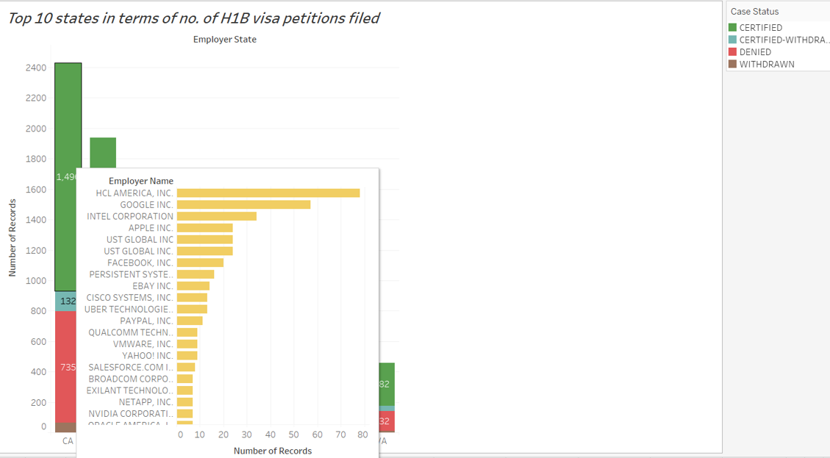
California State has 1496 Certified cases in which Google and HCL America are the ones with most certified cases and there are 735 Denied cases in which Global Logic INC ,Google and Qualcomm have the most number of denied cases.

Slide 9
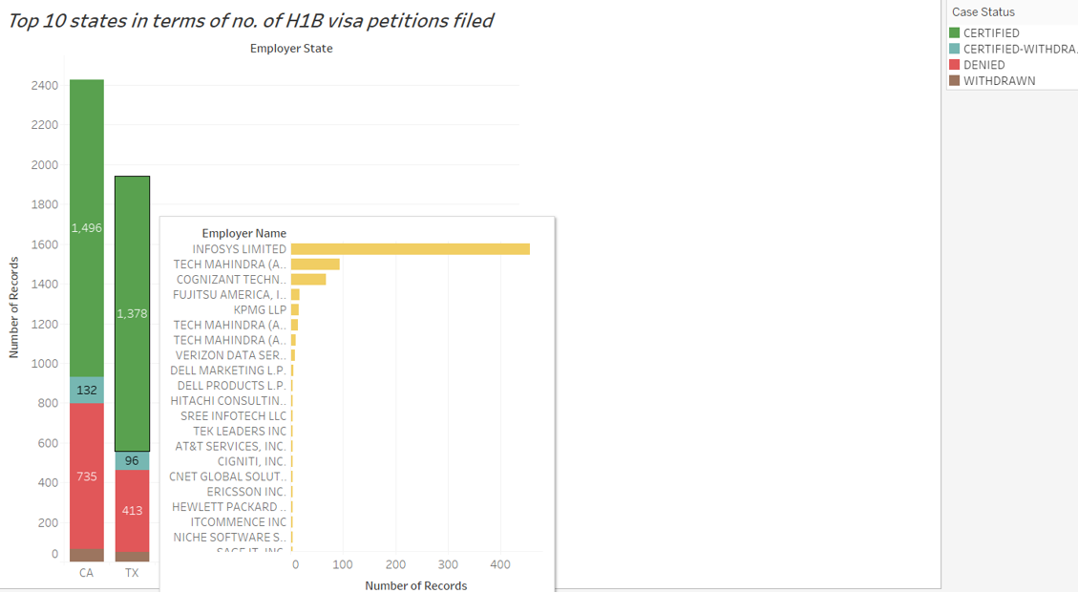
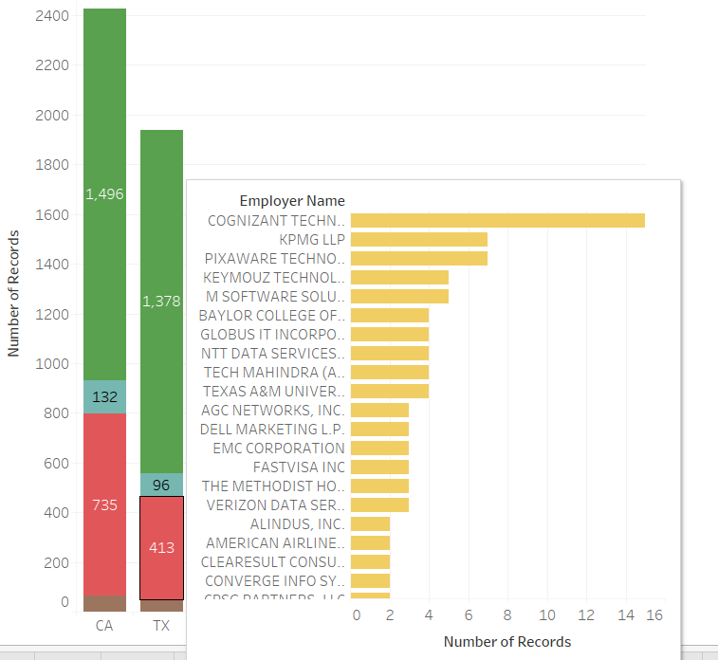
Texas state has 1378 Certified cases in which Infosys and Tech Mahindra are the ones with most certified cases and there are 433 Denied cases in which Cognizant and KPMG have the most number of denied cases.

Slide 10
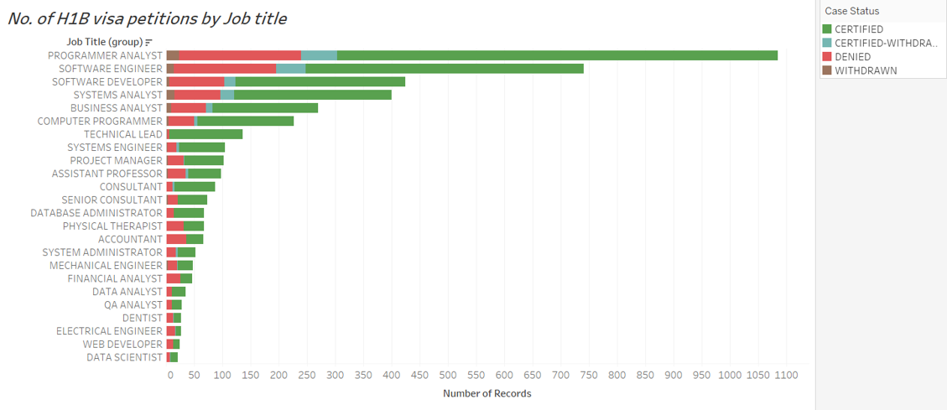
These are the Job titles that have the maximum number of H1B applications certified in Descending order.

Slide 11
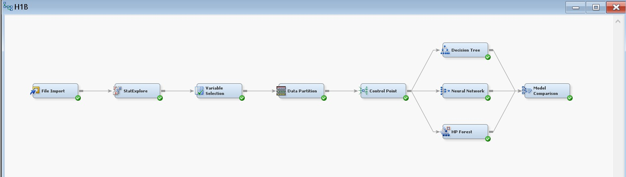
Project Diagram in SAS Miner
In our predictive analysis we use SEMMA steps of SAS EM i.e. Sample, Explore, Modify, Model and Assess

Slide 12
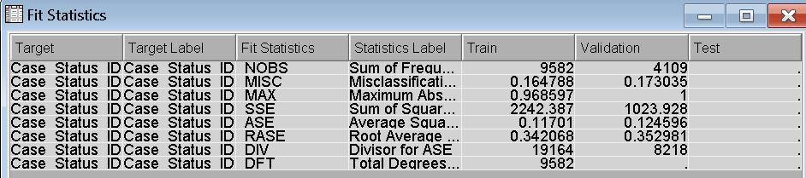
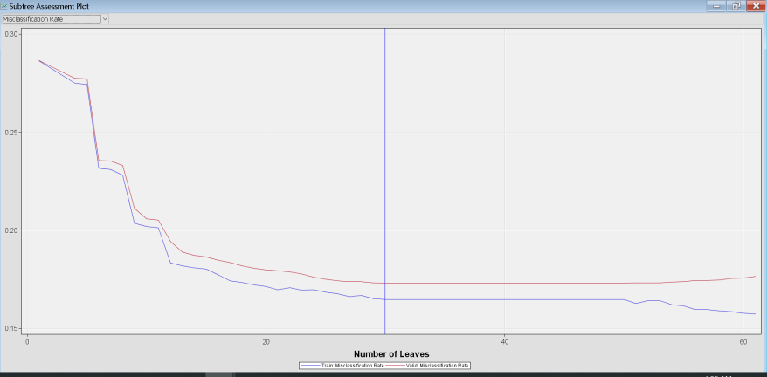
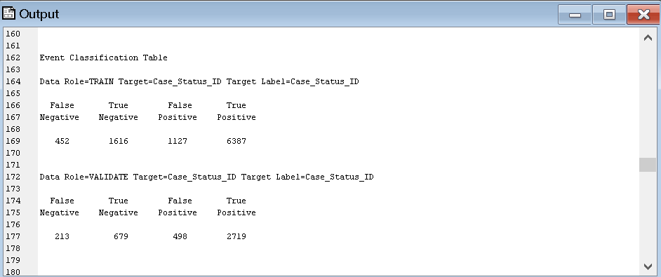
Decision Tree
Decision tree run result -
Fit Statistics shows that the misclassification rate for training and validation dataset is 0.160 and 0.170, respectively.
Misclassification Rate is inversely proportional to number of leaves. As number of leaves increases, misclassification rate decreases. Subtree assessment plot shows that if number of leaves are between 20 and 40, we will get lowest misclassification rate.
Confusion Matrix
As number of Denied cases are low compared to number of Registered cases; confusion matrix result will provide better picture of prediction analysis.

Slide 13
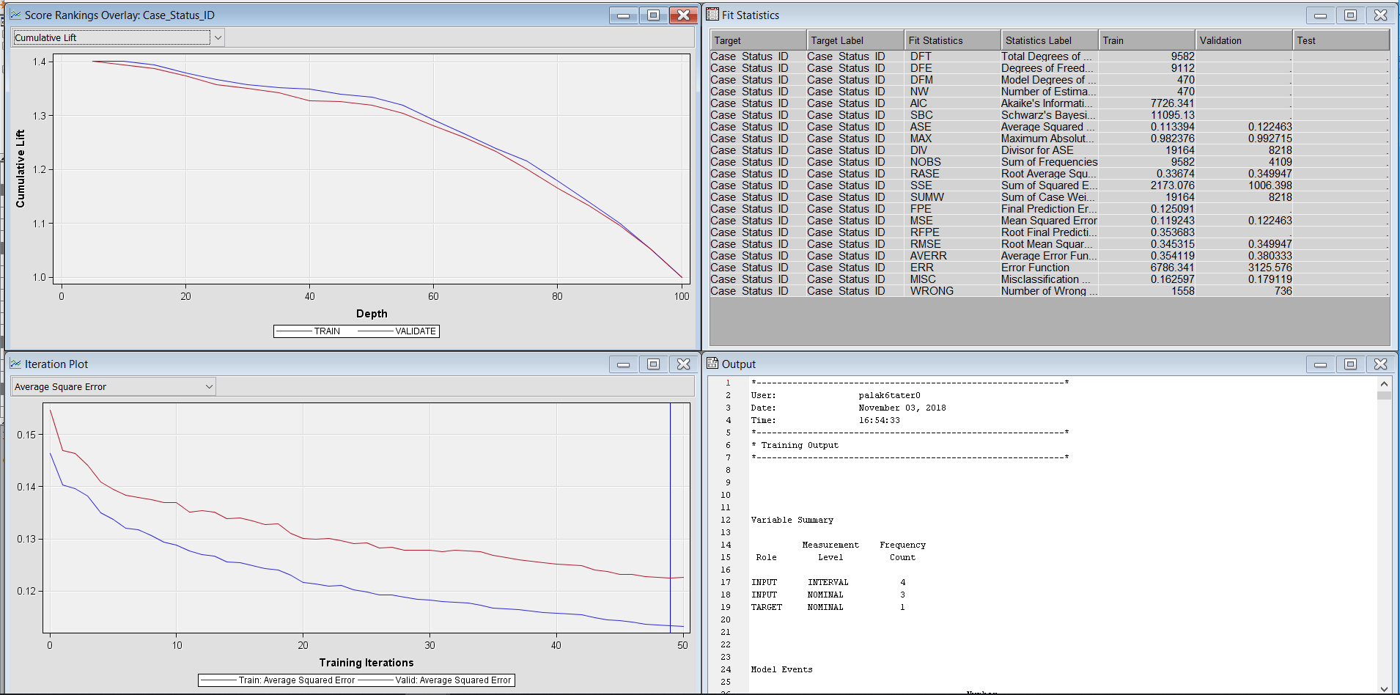
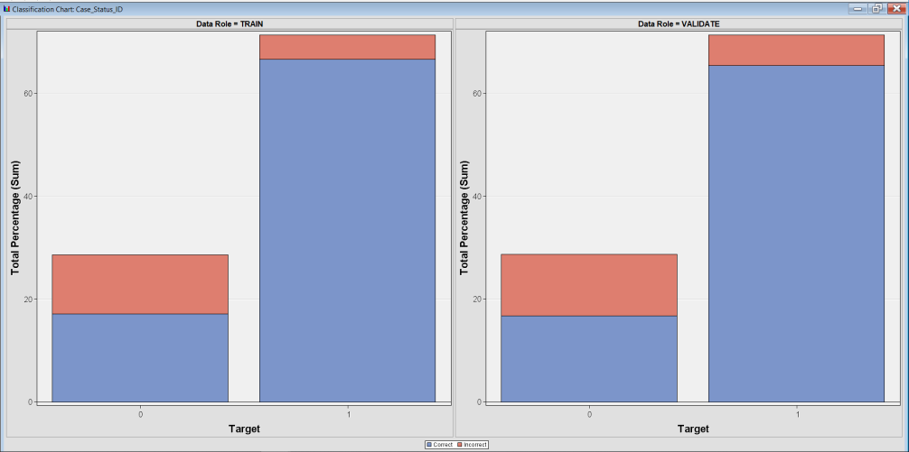
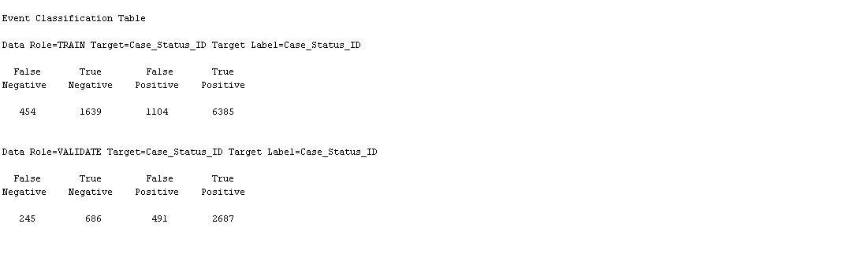
Neural Network
Neural Network run result -
Fit Statistics shows that the misclassification rate for training and validation dataset is 0.162(Train) and 0.179(Validation), respectively.
Here around 67% of the Certified case status have been classified correctly and around 17% of the Denied case status have been classified correctly.
Confusion Matrix
As number of Denied cases are low compared to number of Registered cases; confusion matrix result will provides better picture of prediction analysis.

Slide 14
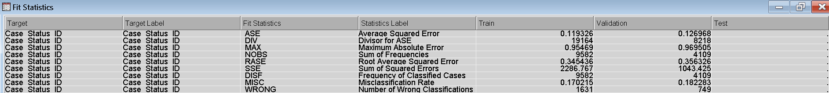
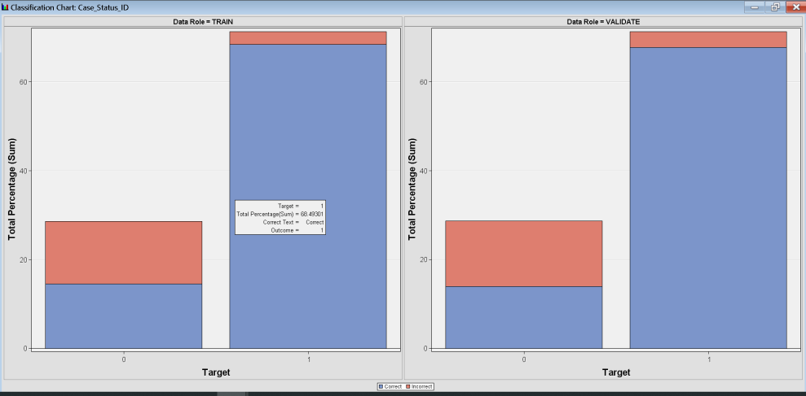
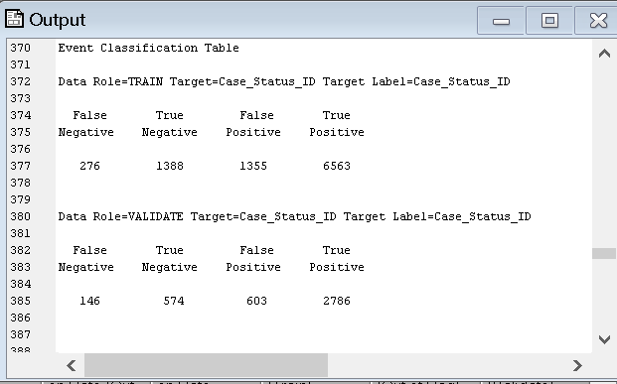
Random Forest Model using HP Random Forest
Random Forest run result
Fit Statistics shows that the misclassification rate for training and validation dataset is 0.17 (Train) and 0.18(Validation), respectively.
Around 68% of the Certified case status have been classified correctly and around 14% of the Denied case status have been classified correctly .
Confusion Matrix
As number of Denied cases are low compared to number of Registered cases; confusion matrix result will provides better picture of prediction analysis.

Slide 15
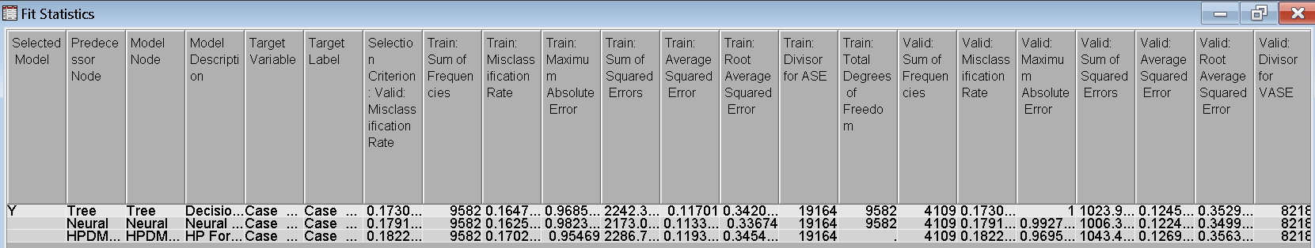
Evaluation Result
By comparing Decision Tree Model, Neural Network Model and Random Forest Model, we can conclude that Decision Tree is predicting more accurately.

Slide 16
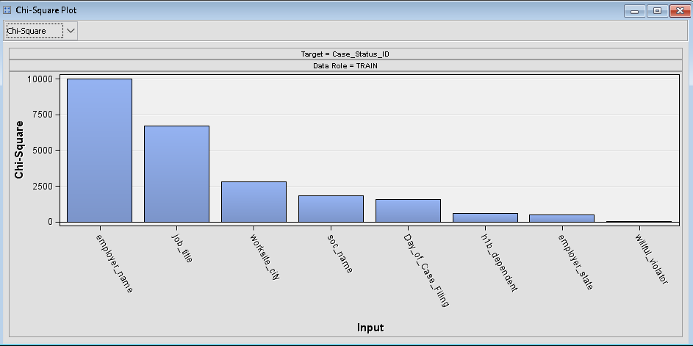
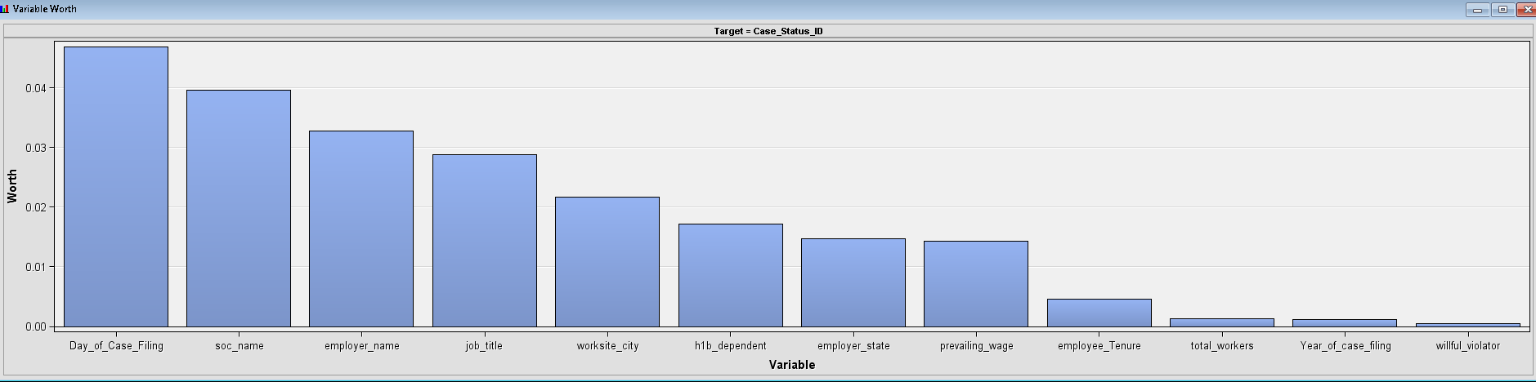
Interesting insights from SAS Miner Predictive Modelling
Based on the Chi Square plot, we noted that the categorical variable that affected the target variable value the most is Employer_name followed by Job_title, Workshire_city, soc_name,Day_of_case_Filing, H1b_Dependent , employer_state and willful_violator.
Based on the Variable Worth Plot,( the worth of each input is calculated from the p-value corresponding to the calculated Chi-Square test statistic) we noted that the day_of_case_filing, Employer_name and SOC_name, job_title and workshire_city.
Both Chi-Square plot and variable worth plot show that Employer_Name, JOB_TITLE and SOC_Name are the most important variable since they have the highest Chi-Square value and also the highest worth.

Slide 17
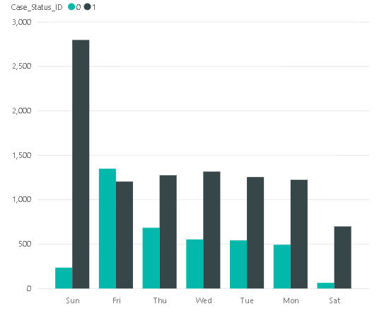
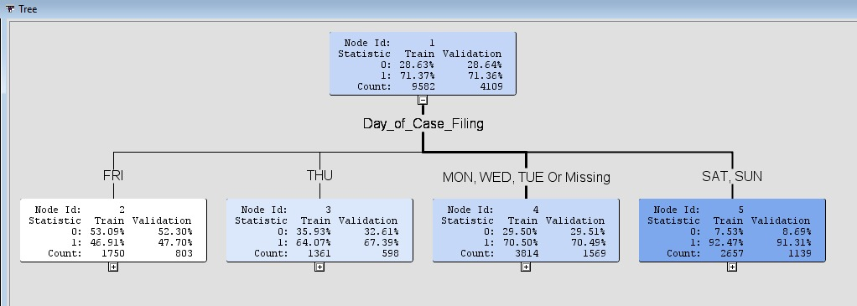
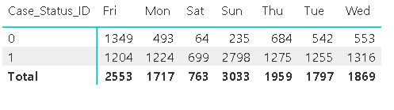
Interesting insights from SAS Miner Predictive Modelling – Contd.
70% applications were approved if day of case filing is Monday or Tuesday or Wednesday.
50% applications were denied if case is filed on Friday.
90% applications were approved if case is filed on Saturday or Sunday.

Slide 18
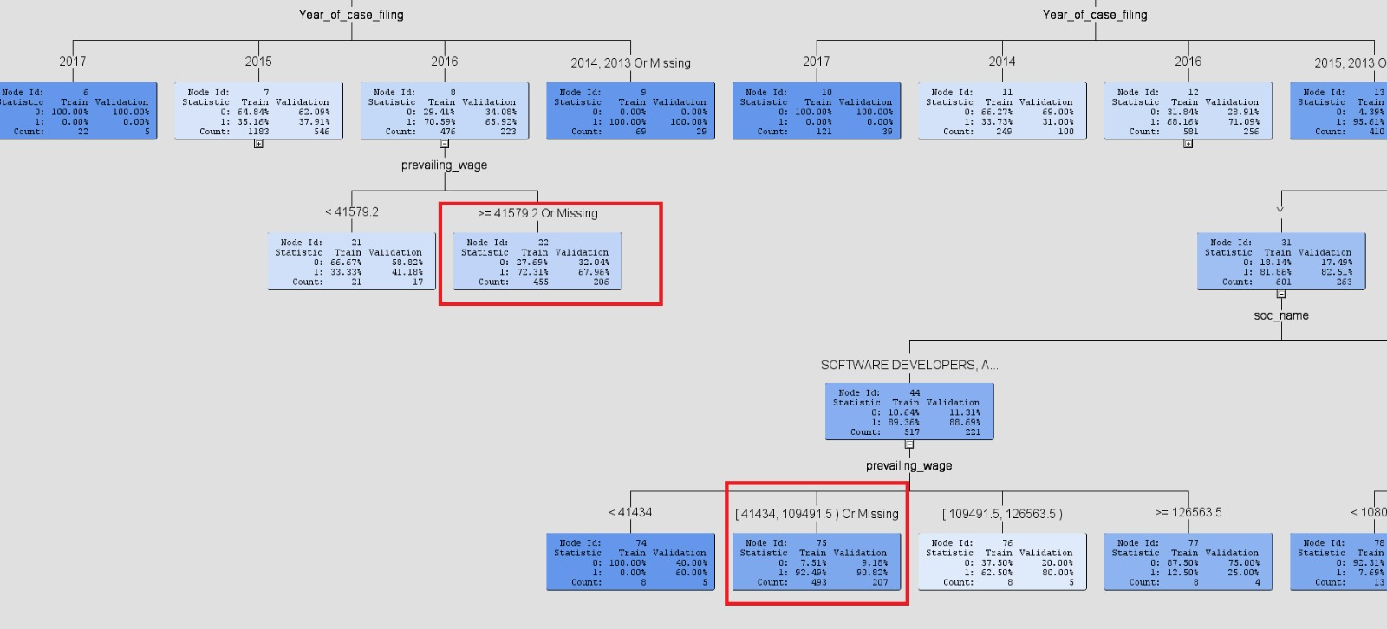
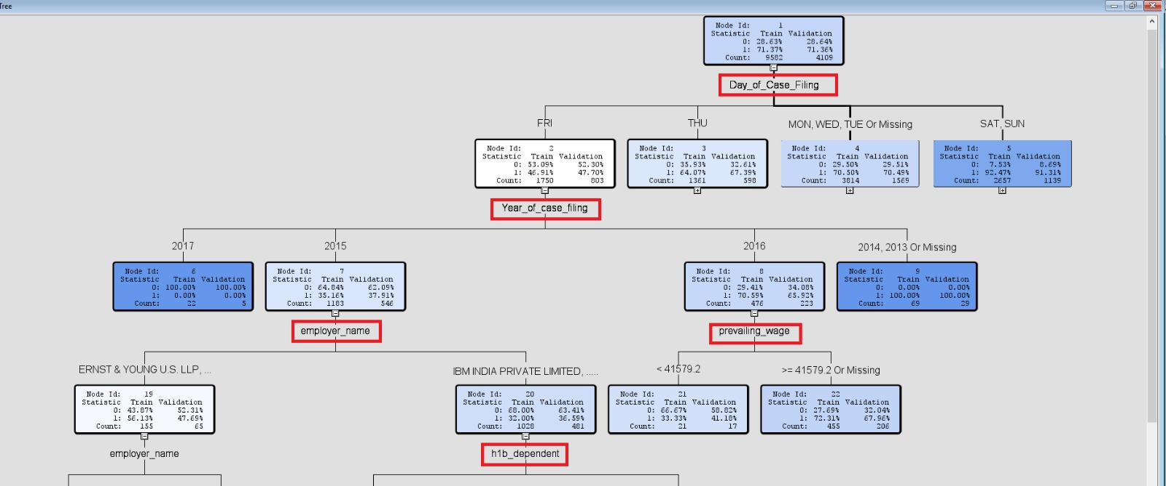
Interesting insights from SAS Miner Predictive Modelling – Contd.
72% cases were approved if prevailing wage is greater than $41000.
Day of Case filing, Year of Case filing, Employer Name, Prevailing wage and H1B dependent are the most important features in deciding case status.

Slide 19
Future Scope & Business Value Recommendations
The project is incorporated on randomized data from H1B 2015, 2016 and 2017 files. We can extend the scope and apply this model on the entire population and see, if there has been a change in any of the predictor’s significance.
For any particular employer, we can design a customized model where the employer can predict whether the applicant will be certified.
If the living expense of each state of the US is also included in the data, this can be combined with the salary in the application and then we can build predictive models on which states have the most comfortable lives and where can employees consider relocating.
In the future, the cases of 2018 could be utilized as test dataset to see the trend for different job titles and different salary range.

Slide 20
Conclusion
Our model and Analysis provide a whole picture of different approval rates compared with different conditions based on previous data. The utilization of machine learning algorithm’s enabled us to analyze the data based on training and learning steps.
In this work, Decision Tree, Random Forest and Neural network were considered for determining the status of H1-B visa applications. Model comparison classifier performs a good collation to combine all these models and predict accuracy. We achieved a best of classification accuracy with decision tree model. We inferred that the state of worksite, year of application, prevailing wages, employer name and SOC-name play an important role in determining the case status of an H-1B application.

Slide 21

Considering that the approval/denial of H1B visa applications are determined on so many attributes, the question that arises is
IS H1B VISA REALLY A LOTTERY ? IF NOT, WHY IS EVEN CALLED SO?

